Slide 1
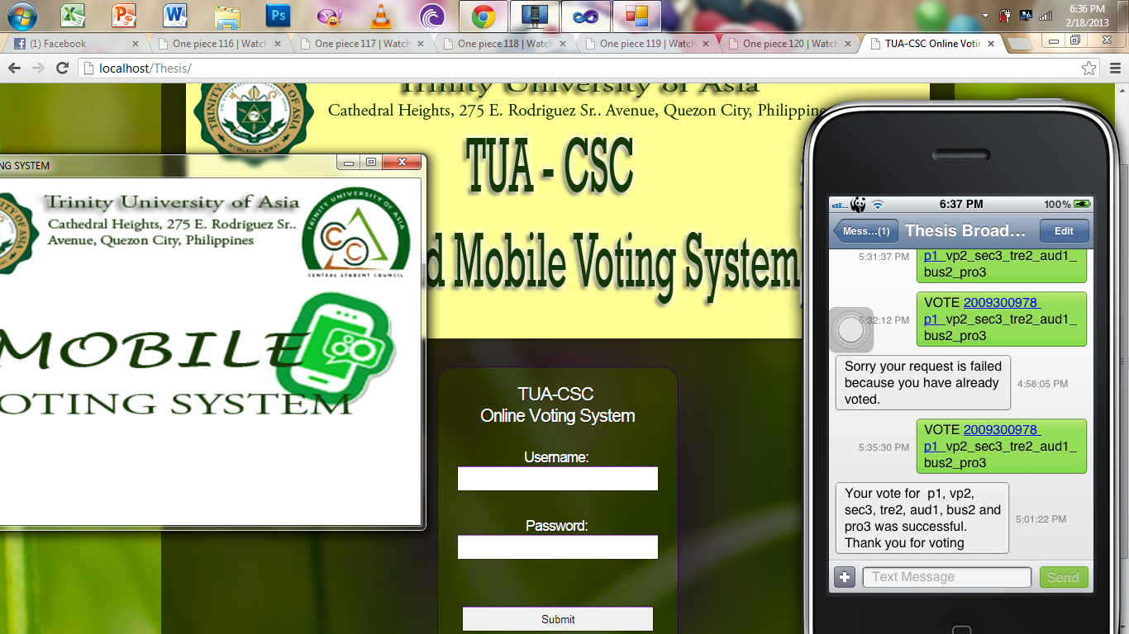
(MANUAL)
Presented by Group 3 – 4CS01
Belga, Roque, Manansala, Pansalin

Slide 2
TUA-CSC Online and Mobile Voting System
(MANUAL)
Presented by Group 3 – 4CS01
Belga, Roque, Manansala, Pansalin

Slide 3

ONLINE & MOBILE VOTING SYSTEM
MANUAL FOR ADMIN

Slide 4
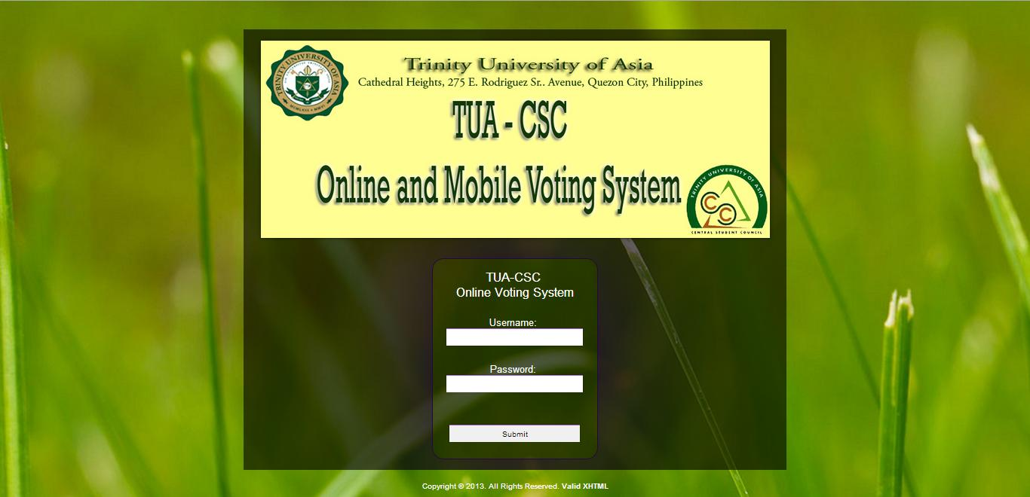
LOG-IN PAGE

Slide 5
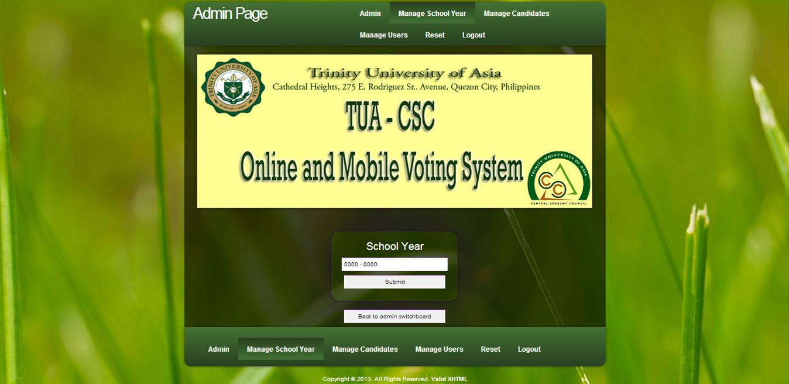
MANAGE SCHOOL YEAR

Slide 6
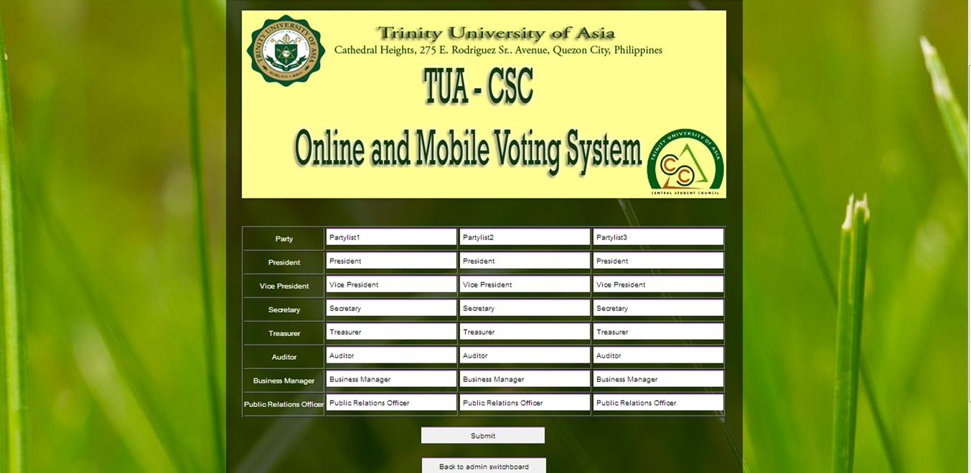
MANAGE candidates

Slide 7
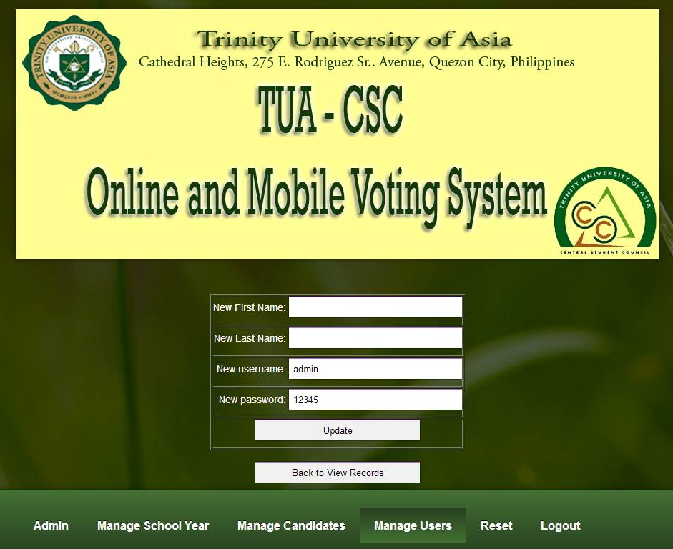
MANAGE users

Slide 8
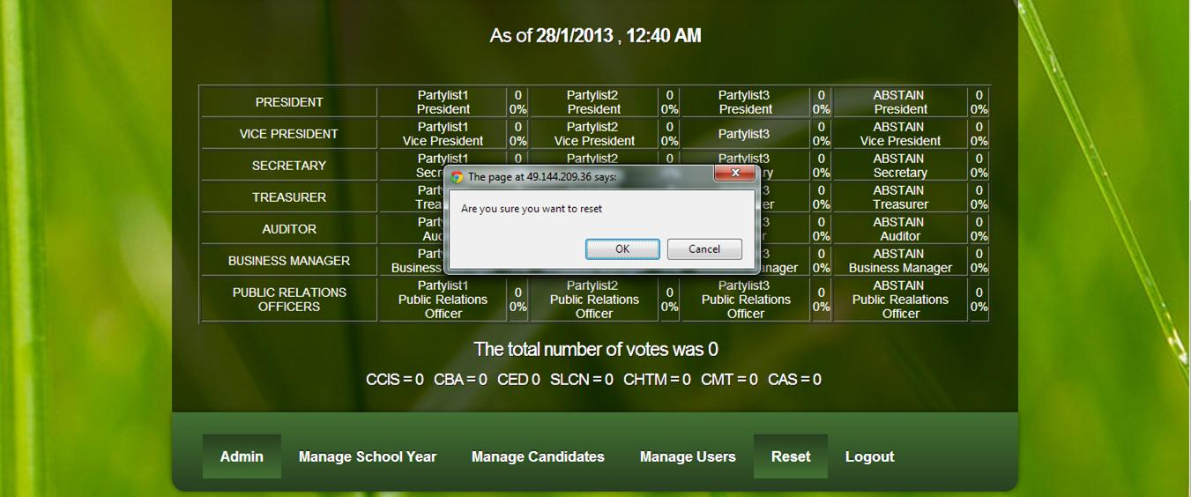
reset

Slide 9

ONLINE VOTING SYSTEM
MANUAL FOR voter

Slide 10
LOG-IN PAGE

Slide 11
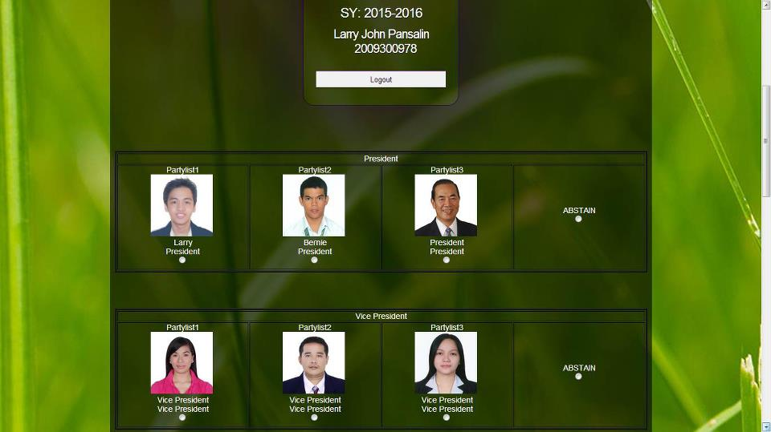
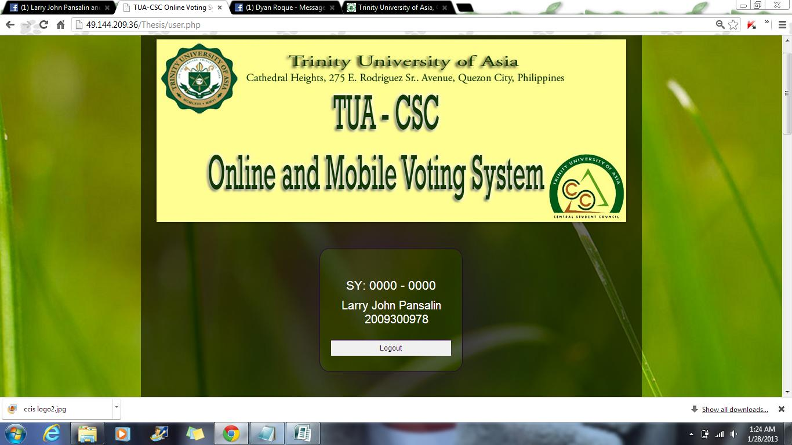
VOTING PAGE

Slide 12
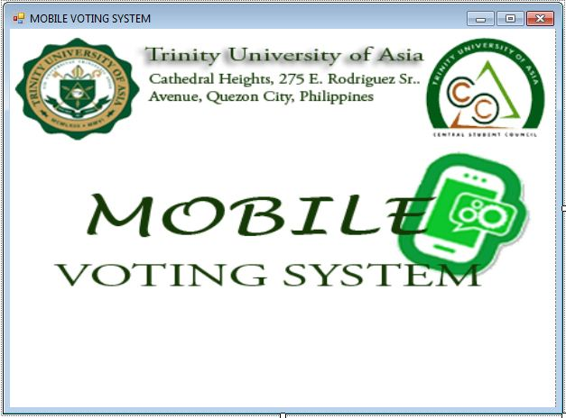
MOBILE VOTING SYSTEM
MANUAL FOR voter

Slide 13
Keywords:
p – President
vp – Vice President
sec – Secretary
tre – Treasurer
aud – Auditor
bus – Business Manager
pro – Public relations officer
The numbers attached to the keywords example: vp1 represents from what party list it belongs.
Number of broadband prepaid sim: 09053299451

